Slide 1


A.Y 2020-2021
Email Security

Slide 2
Introduction to E-mail System
E-mail is the popular form of sending or exchanging information between two or many parties
Despite being popular, malware, spam and phishing attacks are executed
E-mail also acts enterprise network valuable data
the entry point to gain access
for the to their

Slide 3
E-mail Security
It deals with the different techniques to secure the information sent through email
The e-mail accounts are prevented from unauthorized access, loss, or compromise
It is important to provide e-mail security as individuals and business organizations expand their extensive communication through email

Slide 4
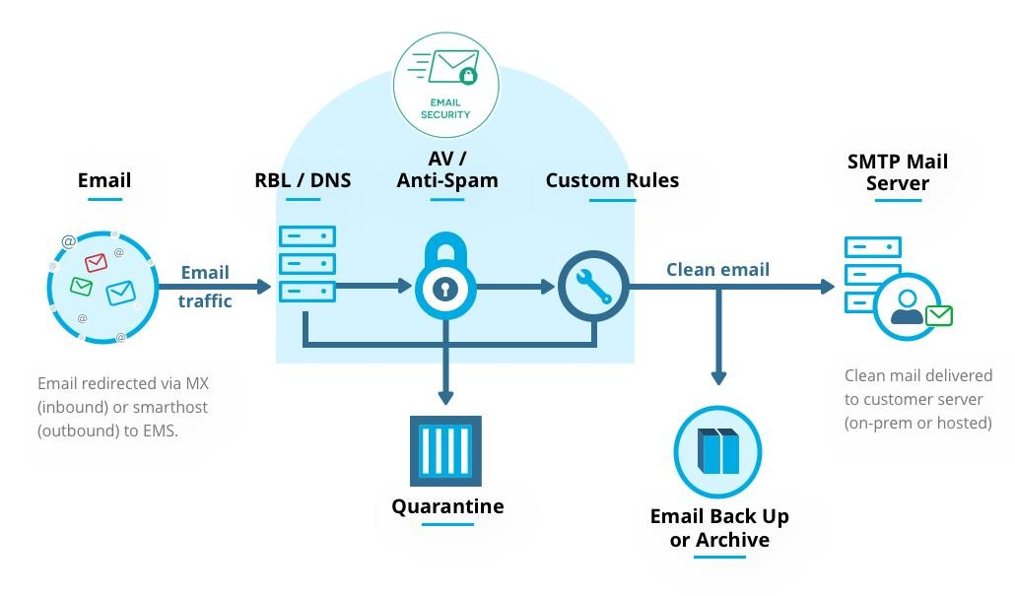
E-mail Security

Slide 5
Need for E-mail Security
Every organisation must employ e-mail administrators responsible in providing security to the e-mail system
It is important to provide e-mail security as individuals and business organizations expand their extensive communications through e-mail
Hence E-mail messages must be secured as they are delivered and received across untrusted networks

Slide 6
Importance of E-mail Security
It provides security over external networks security i.e., outside the organization’s boundary
It maintains the CIA of information transferred through e-mail
It provides implementation of good management system planning by continuous monitoring
It also maintains the effectiveness of the e-mail system and IT infrastructure

Slide 7

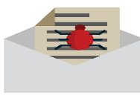

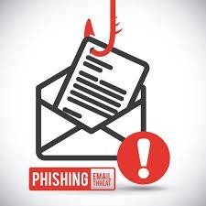
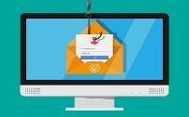
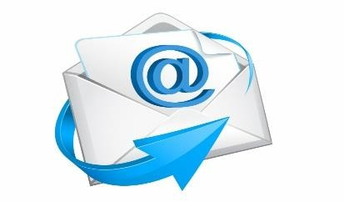


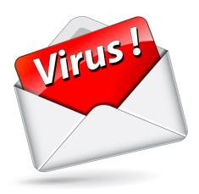
Common Threats to e-mail security
Malwares
Spam
Phishing
Baiting
Threats to E-mail Security
Social engineering
Unintentional acts
Entities with malicious intent

Slide 8
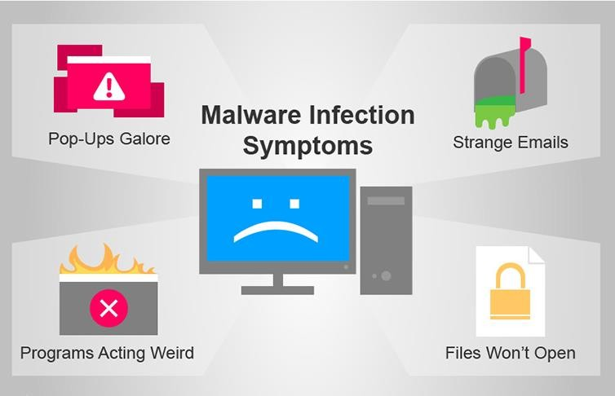
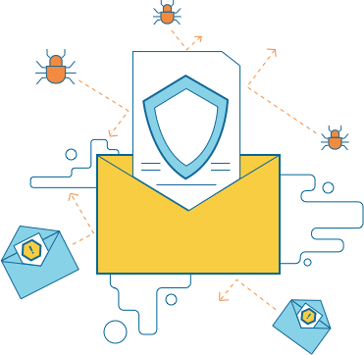
Malwares infecting E-mail systems

Slide 9
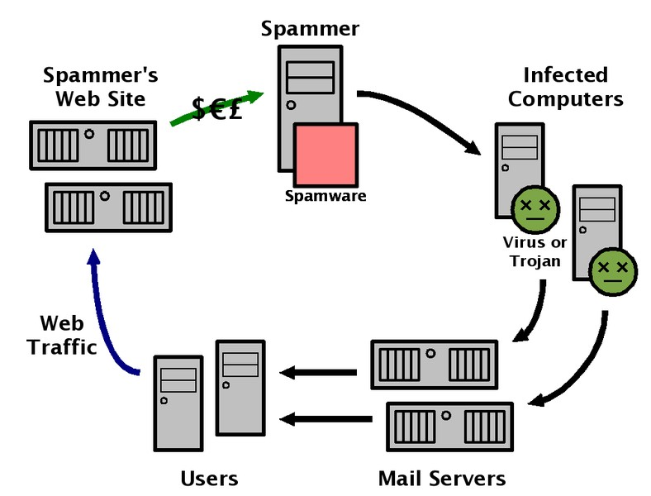
Cycle of spam in E-mail system

Slide 10
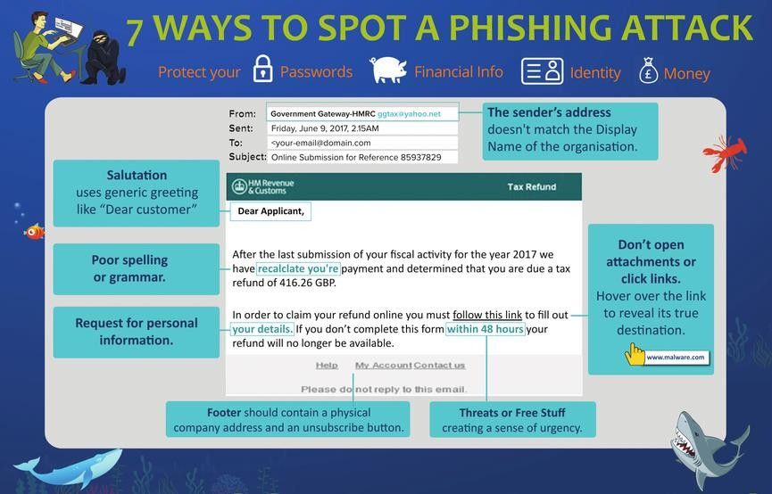
Ways to spot phishing E-mails

Slide 11
Maintaining a Secure Mail System
Maintaining a mail system security is a continuous process that requires constant effort, resources, and vigilance
Some of the actions taken are as follows,
Configure, Protect, and Analyze Log Files
Back up Data Frequently
Protect against Malware
Perform Periodic Security Testing

Slide 12
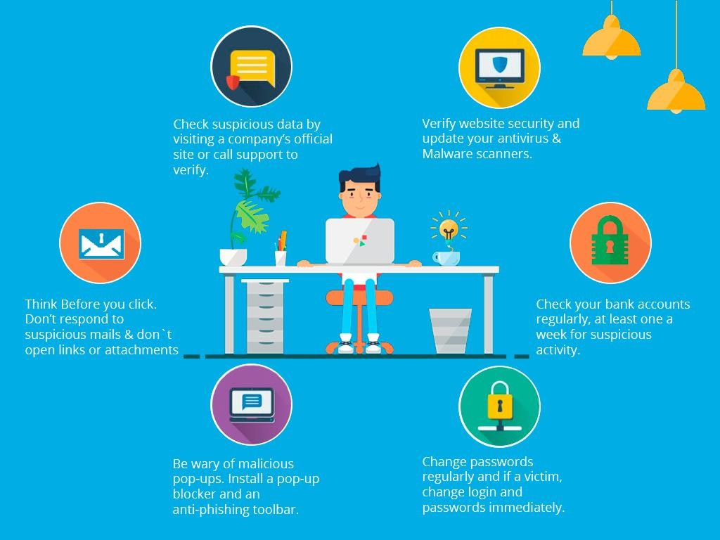
Maintaining a Secure Mail System

Slide 13
E-mail Encryption Techniques
It refers to the technique of encrypting e-mail messages to ensure confidentiality of the e-mail recipients
There are two types of encryption types used in e-mail security. They are
Public Key Cryptography Cryptography
End-to-End Encryption
or Asymmetric

Slide 14
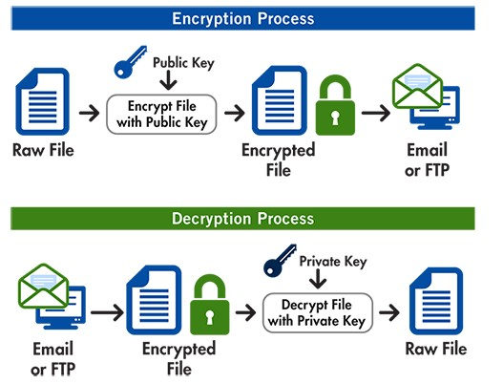
Public Key Cryptography
E-mail encryption is based on the cryptography function
public-key
This function works with the help of two keys namely
public-key used for encrypting the message and
private-key used for decrypting the message

Slide 15
End-to-End Encryption
It encrypts and decrypts e-mail messages at the end points
With the help of end-to-end encryption, the source and destination recipient’s messages are encrypted and they cannot be read by e- mail service providers

Slide 16
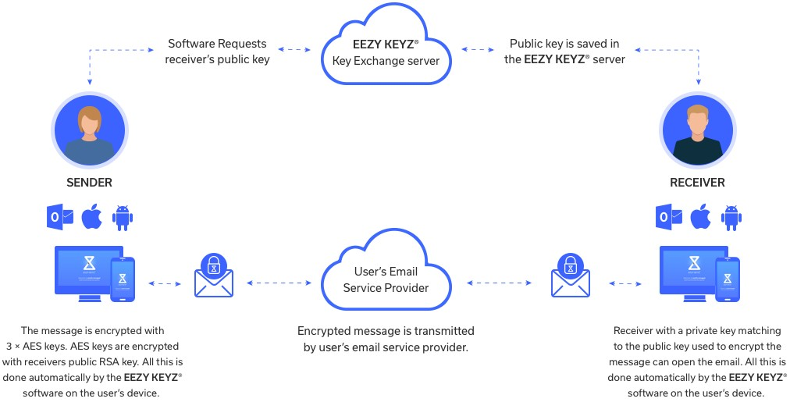
End-to-End Encryption Example

Slide 17





Protocols used in end-to-end e-mail encryption
 | End-to-end Encryption
Bit Message
GNU Privacy Guard (GPG)
Pretty Good Privacy (PGP)
Secure/Multipurpose Internet Mail Extensions (S/MIME)

Slide 18
Open PGP Encryption
OpenPGP is an encryption standard used in end- to-end e-mail encryption
It enables to store sensitive information and to transmit the information across insecure networks
It puts a limitation to end-to-end encryption affecting the usability of the messages
This method protects only the contents and still the metadata prone to untrusted parties

Slide 19
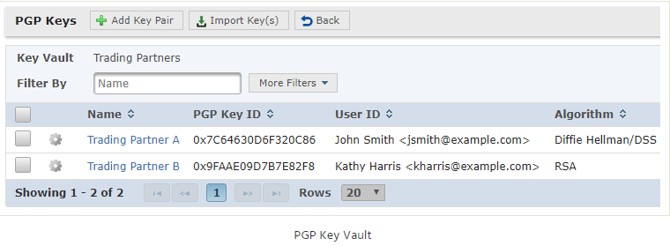
How to get started with PGP?
OpenPGP Key Vault

Slide 20
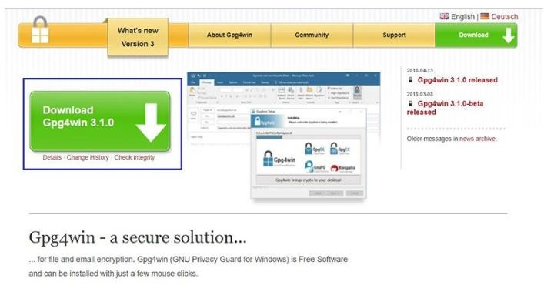
Step-1 Download Gpg4win

Slide 21
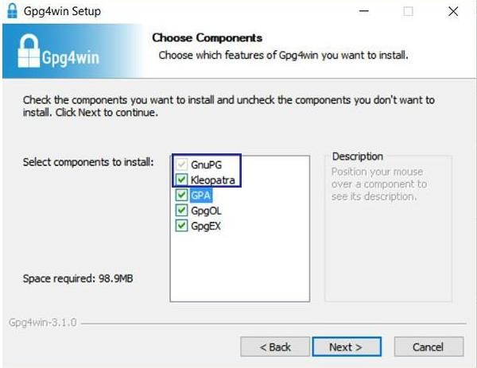
Step-2 Set up Gpg4win

Slide 22
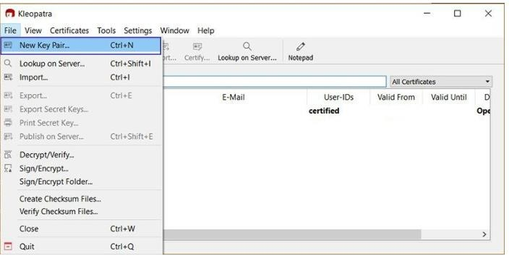
Step-3 and 4 Find Kleopatra Program and Create New Key Pair Certificate

Slide 23
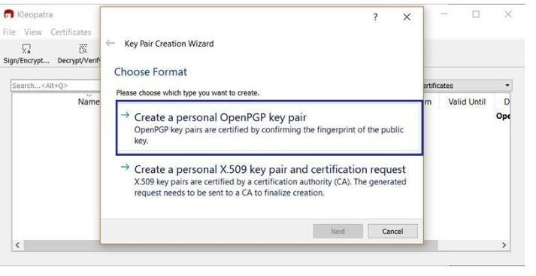
Step-5 Create a Personal OpenPGP key pair

Slide 24
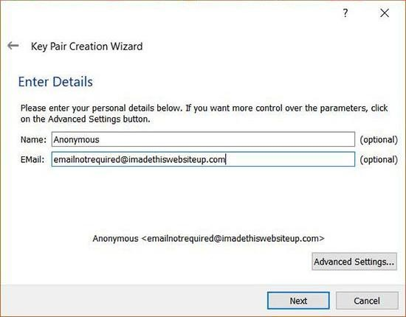
Step-6 Enter details in Key Pair Creation Wizard

Slide 25
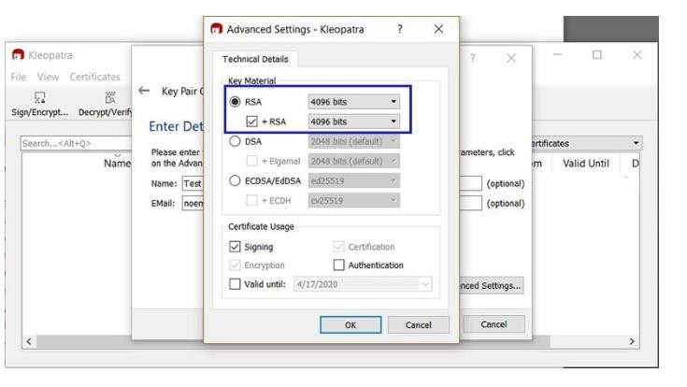
Step-7 Advanced Settings in Kleopatra

Slide 26
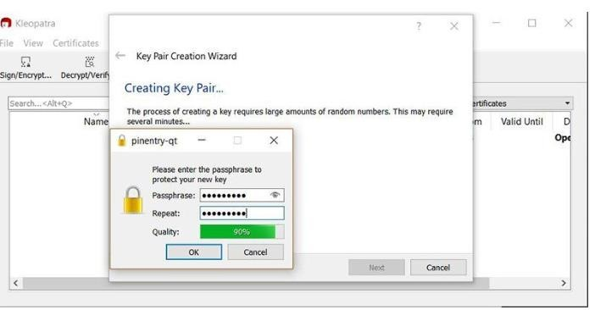
Step-8 Set up Passphrase for new key

Slide 27
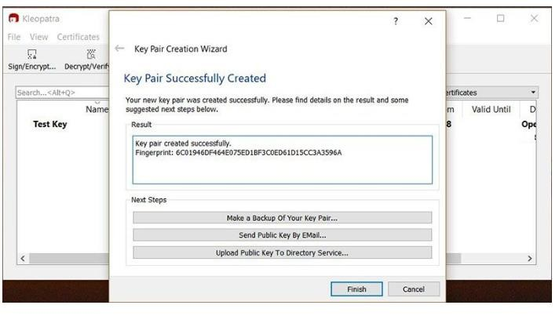
Step-9 Creation of Key pairs

Slide 28
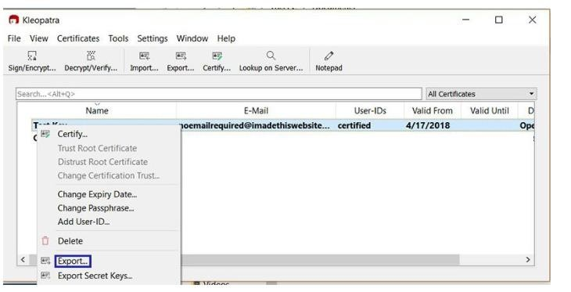
Step-10 Export Public Key

Slide 29
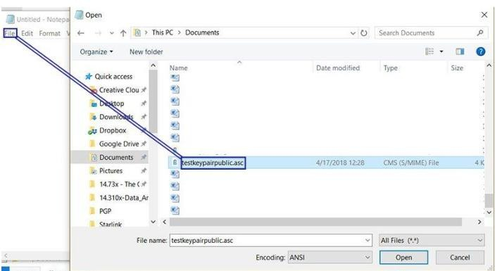
Step-11 and 12 Save and Open the saved Public key file

Slide 30
End user e-mail security best practices
Avoiding unwanted links and opening of attachments from unknown email recipients
Creating strong passwords and changing them on regular basis
Not disclosing passwords even with colleagues
Verification of sensitive information during transfer with the help of spam filters
Using anti-virus software to block vulnerabilities
Using private software such as VPN’s instead of public Wi-Fi connections

Slide 31
Securing enterprise e-mail systems
Educating employees by engaging them on real-time e-mail security risks
Creation of strong passwords based on rules and mandatorily changing them every month strictly
Protecting e-mail contents using encryption techniques
Using BYOD security to access e-mail on personal devices
Using secure login using encryption methods on web mail applications
Deploying malware scanners and tools to scan and block e-mails with malicious contents
Data protection solutions to identify and sensitive data over e-mail transmissions
prevent
34

Slide 32
Conclusion
Users must definitely understand the security threats faced by e-mail system
The important features of secure e-mail systems and the encryption techniques that can be used to protect sensitive information are shared in this module

Slide 33
Thank you!

